Slide 1
CRIME INCIDENT REPORTS
Jiangyun Wang
Northeastern University, Boston, MA, USA

Slide 2
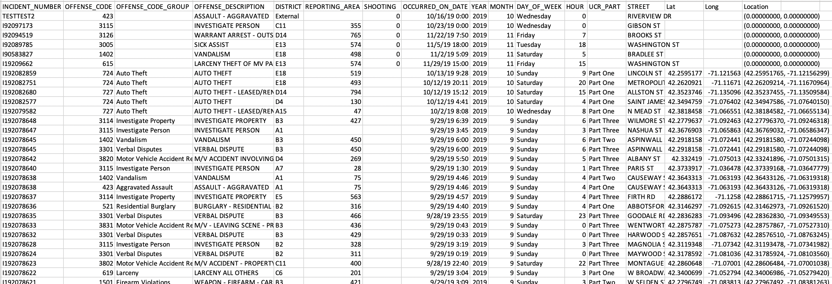
Introduction
Generally, the project is to analyze crime incidents in Boston by finding some patterns on different aspects: like time, offense group and location.
This project includes two data sources and both of them are from the Boston government website -- Analyze Boston

Slide 3
Goals
1. Relation of time and crime incident numbers
- Months
- Seasons
- Day of week
2. Relation of offense group and crime incident numbers
- Motor Vehicle Accident Response
- Larceny
3. Relation of location and crime incident numbers.
- WASHINGTON ST

Slide 4
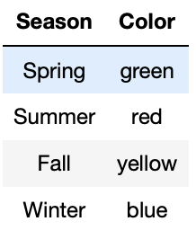
Relation of Time and Crime Incident Numbers

Slide 5
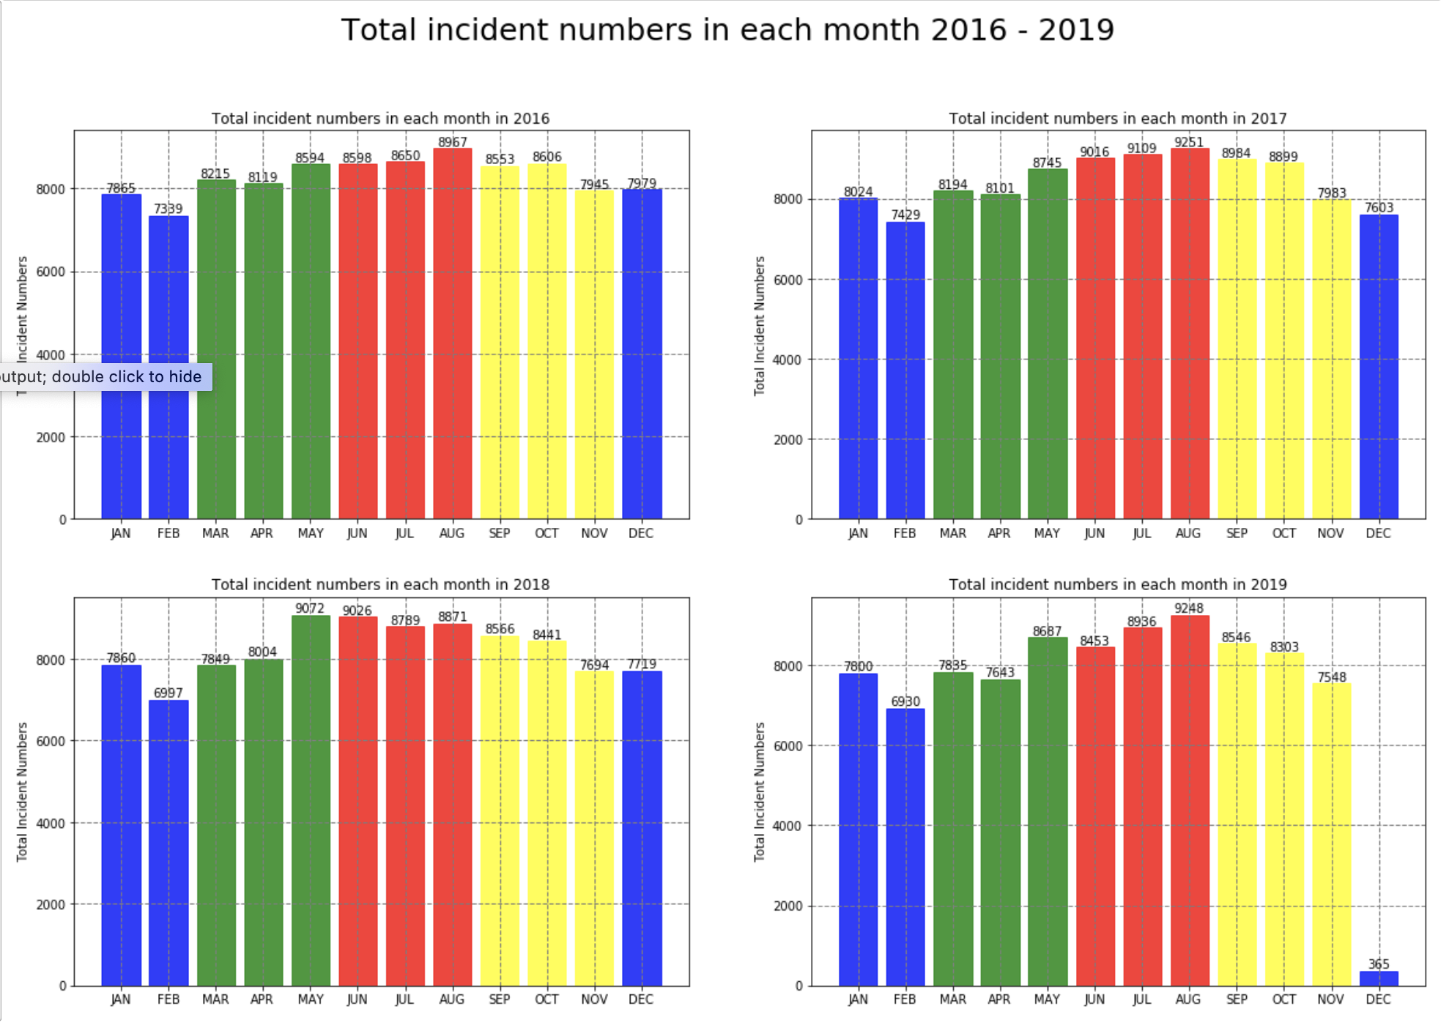
Months
Suggestions: BPD can deploy more police from May to October, and less in February. (The vocation of the police can be more flexible in February)

Slide 6
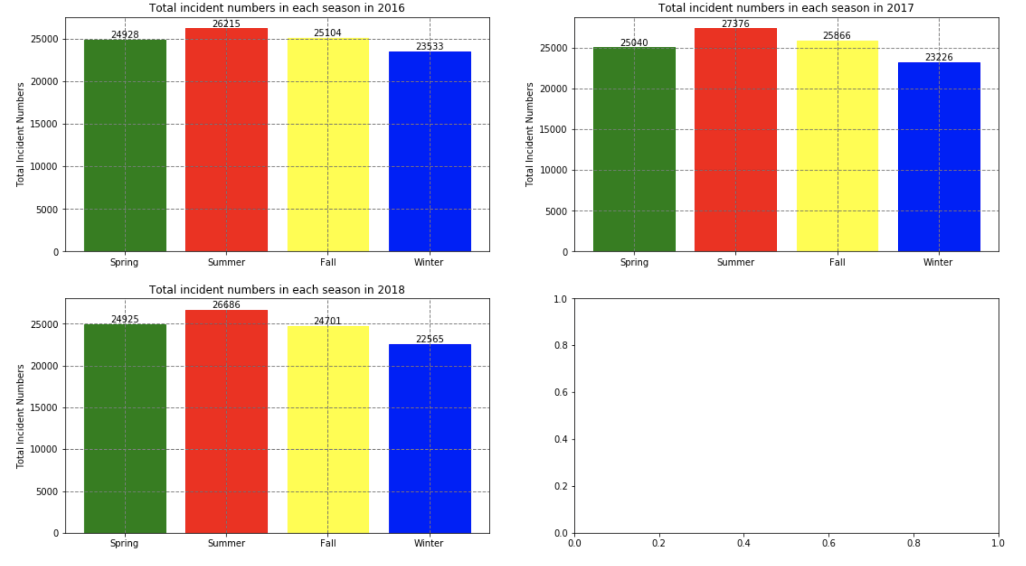
Seasons

Slide 7
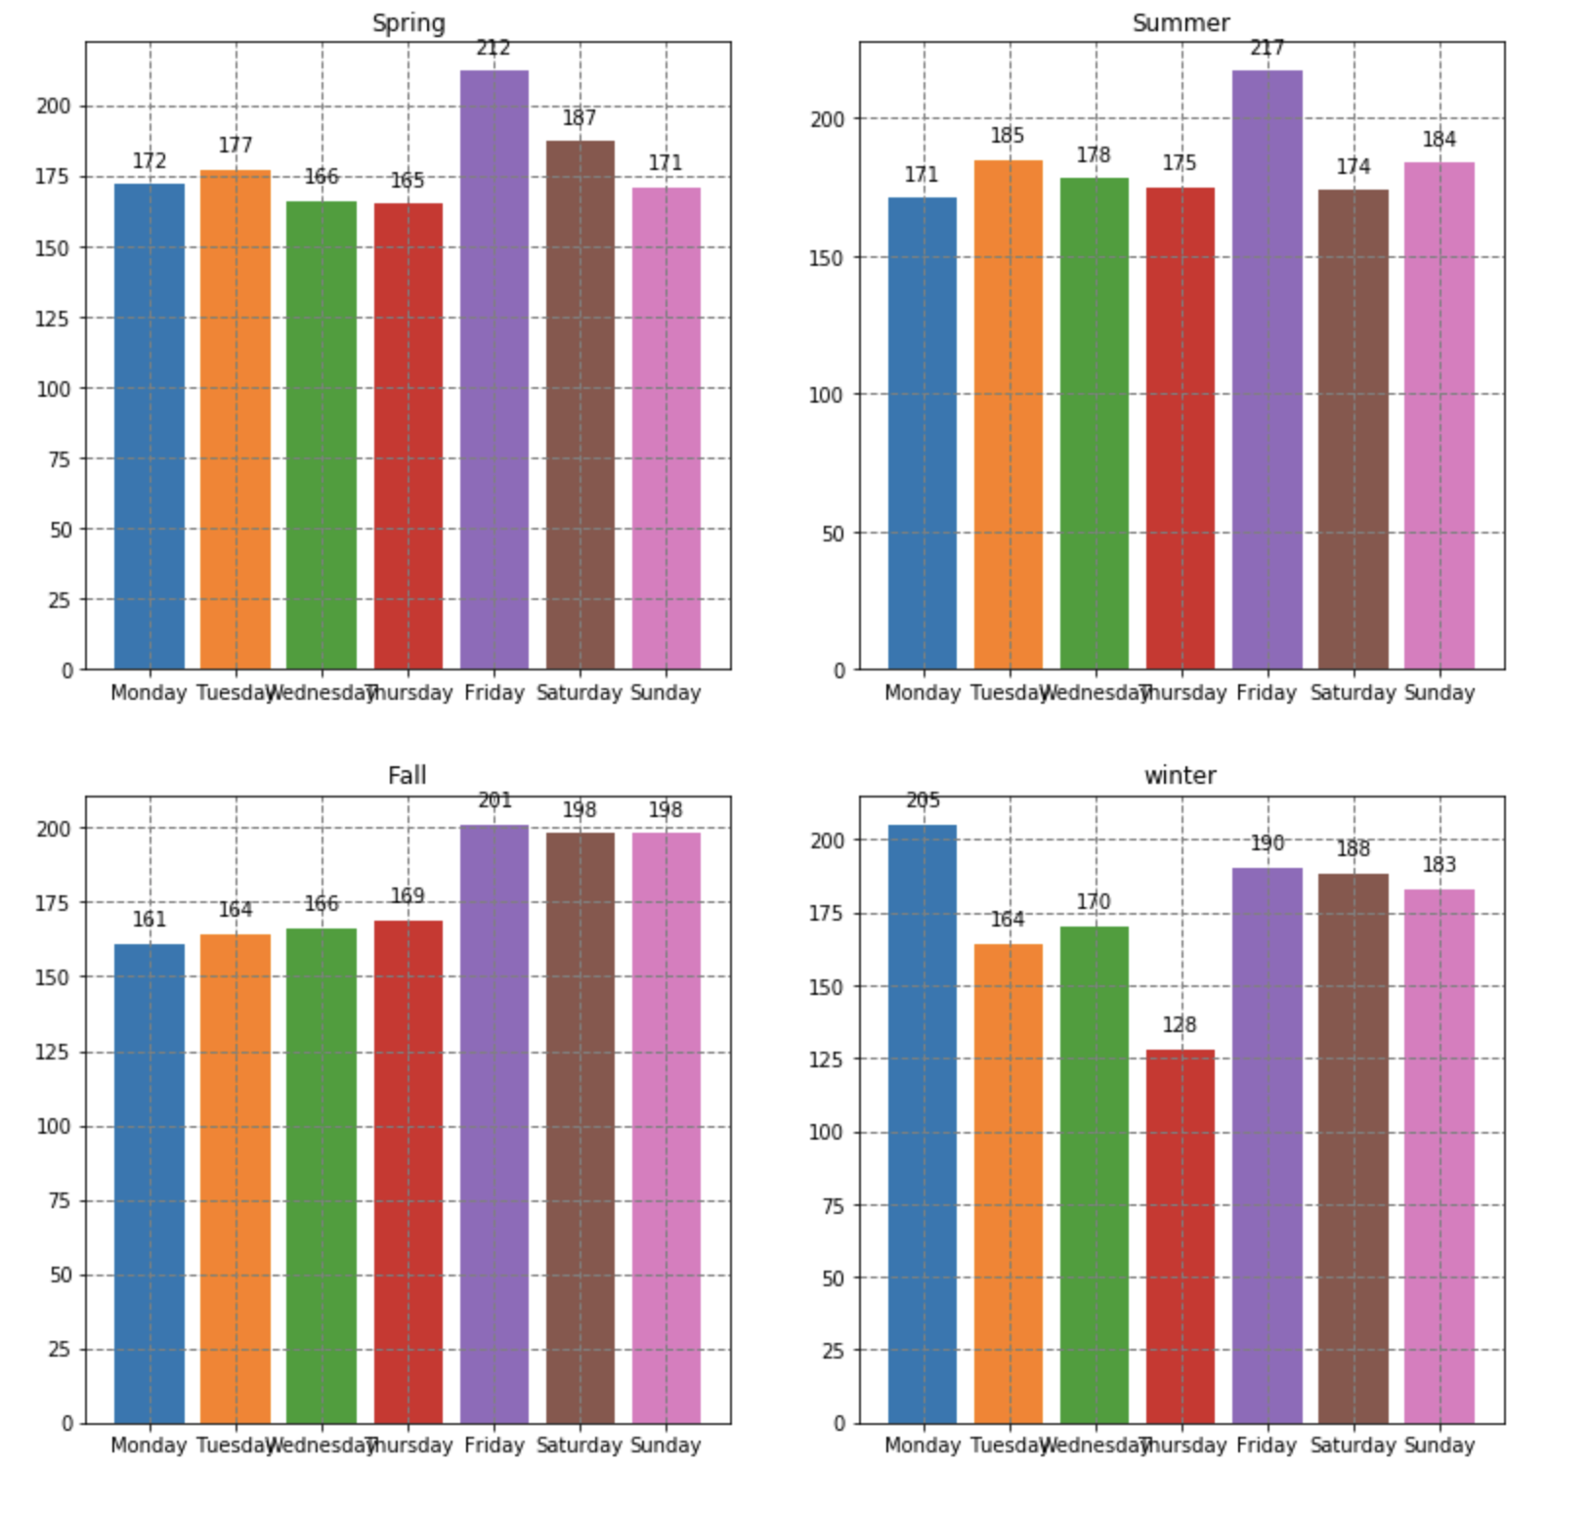
Day of Week
Suggestion: BPD can reasonably deploy the police on each day of week to avoid wasting the police or the shortage of the police on the crime scene.

Slide 8
Relation of offense group and crime incident numbers

Slide 9
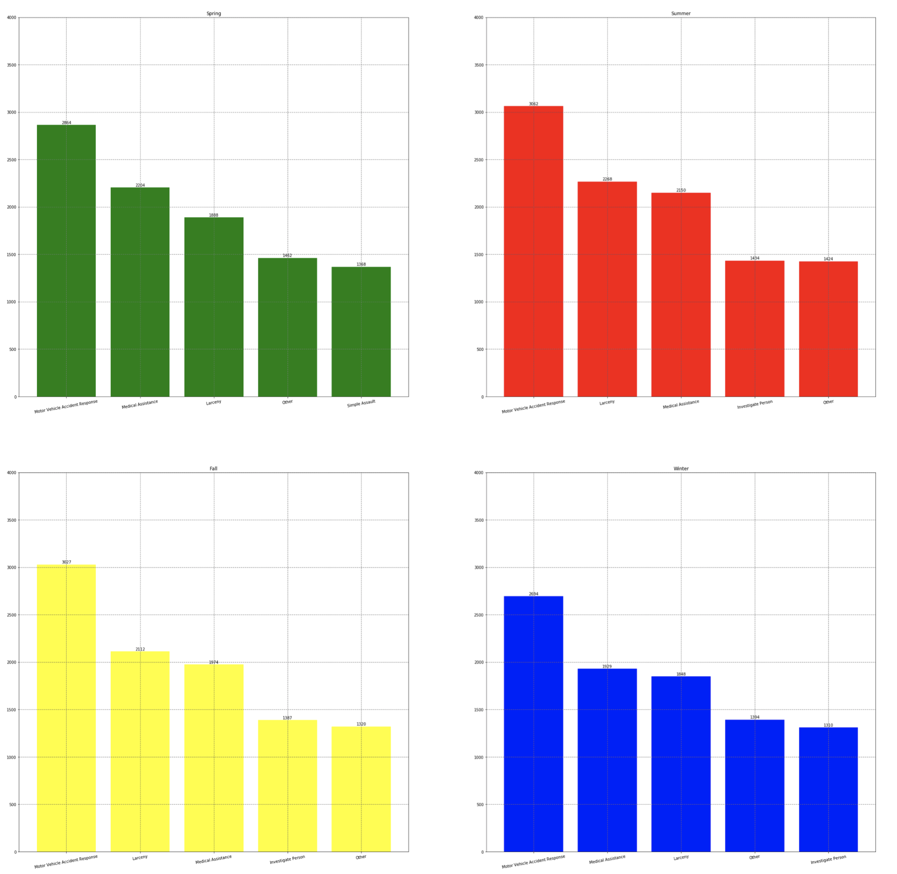
Top 5 offense groups with the most incident numbers in each season in 2018

Slide 10
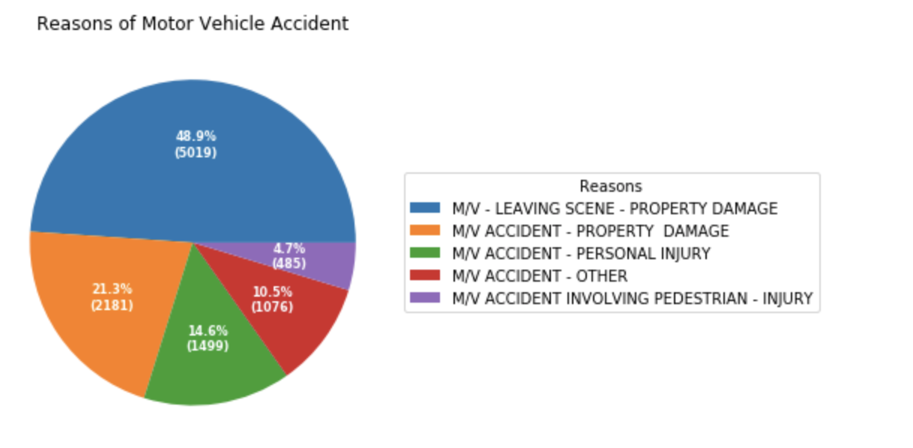
Motor Vehicle Accident
Suggestions: BPD can implement activities of first-aid to enable people to take first-aid measures in Motor Vehicle Accidents. It is better for them to cooperate with RMV to add one test for driving license: first-aid test.

Slide 11
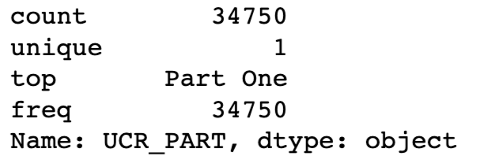
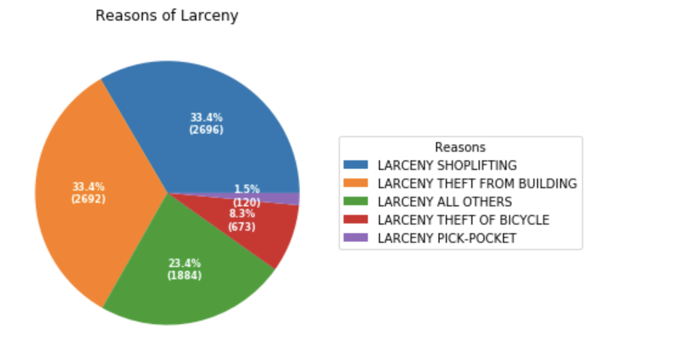
Larceny
Suggestions: It is better for merchants to install surveillance cameras in stores, which can help BPD solve the case quickly by the footage. For individuals, BPD can broadcast to raise individual's vigilance of the safety of their personal belongings.

Slide 12
Relation of Location and crime incident numbers

Slide 13
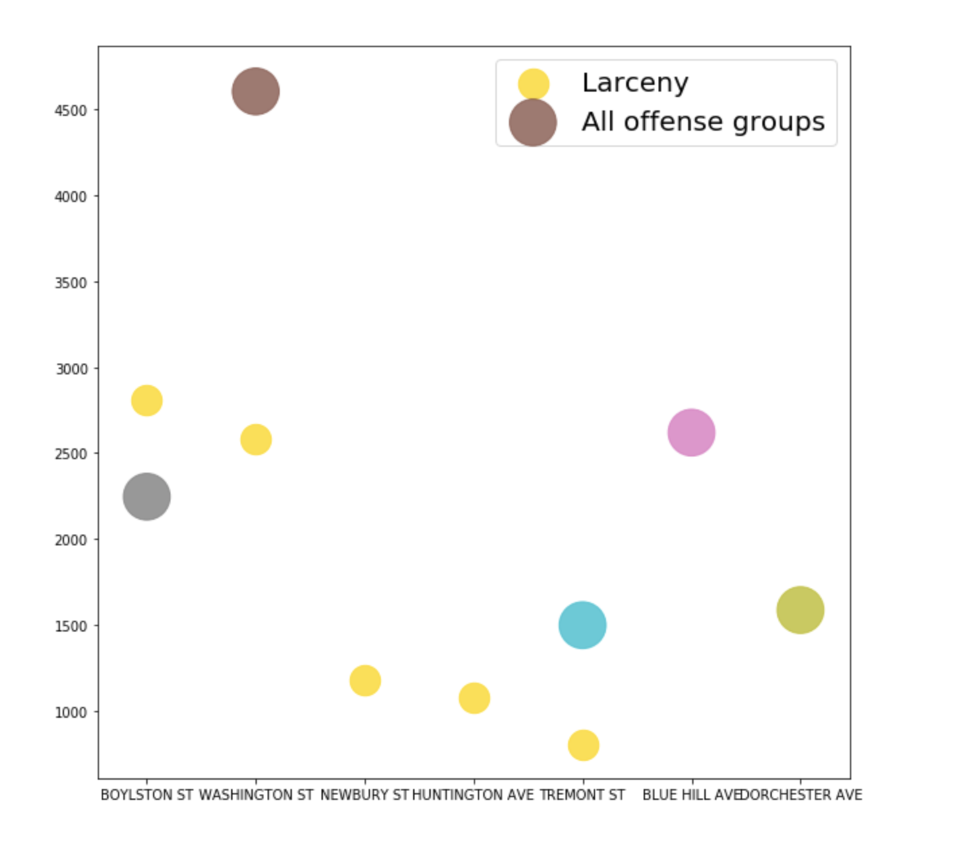
Top 5 streets hold most incident numbers of Larceny and all offense groups in 2018

Slide 14
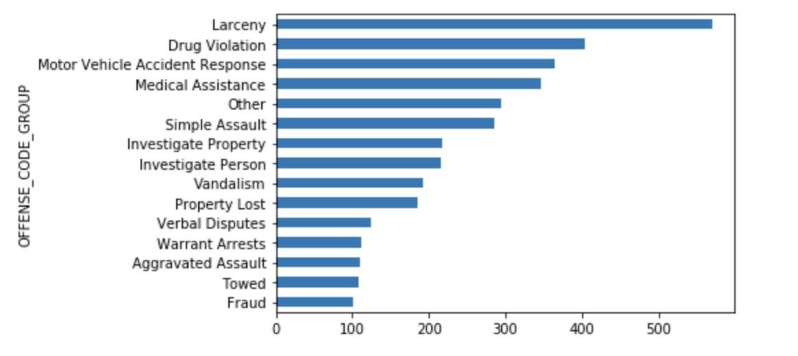
WASHINGTON ST

Slide 15
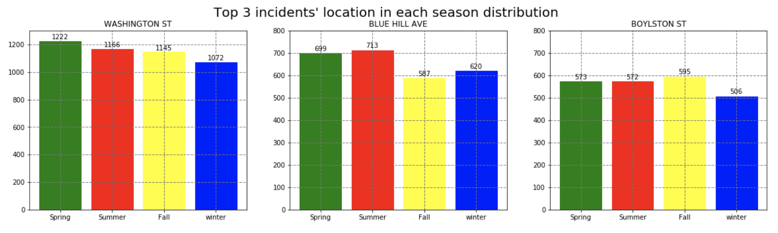
Top 3 incidents' location in each season distribution
Suggestions: BPD should deploy more police in Washington st.

Slide 16
COncluSions
1. Relation of time and crime incident numbers
a. Months:
- From May to October, there are always more than 8000 incidents monthly
- February is always the month with the least crime incident numbers
b. Seasons: Summer is the season which has the most incident numbers and Winter is the one with least incident numbers.
c. Day of week:
- The day of Friday in Spring, Summer, and Fall occurs more incidents. And the day of Monday in Winter occurs more incidents.
- Generally, there is less incidents happen from Tuesday to Thursday in each season.

Slide 17
2. Relation of offense group and crime incident numbers
a. Motor Vehicle Accident Response, Medical Assistance, and Larceny are always the top 3 offence group with most incident numbers in each season.
b. Motor Vehicle Accident Response's incident numbers are far beyond other offense groups.
- About 70% of Motor Vehicle Accidents only causes property damage, which about 19% of Motor Vehicle Accidents only causes people injured.
c. Larceny:
- The major victims of 'LARCENY SHOPLIFTING' and 'LARCENY THEFT FROM BUILDING'(about 67%) are merchants and the other group of victims of 'LARCENY THEFT OF BICYCLE' and 'LARCENY PICK-POCKET'(about 10%) are individuals.
3. Relation of location and crime incident numbers
a. Washington st: it is the top one among all offense groups with the most incidents, and it is the second most larceny incident numbers.
- top 3 offense groups with the most incident numbers are: Larceny, Drug Violation, and Moto Vehicle Accident Response.
- Compare to Washington street(top 1) and Boylston street(top 3), each season's incident numbers in Washington street is twice as the one in Boylston street.
b. Top 3 streets with the most offense incident numbers: Washington st, Blue hill ave., Boylston st
c. Top 3 streets with the most larceny incident numbers: Boylston st, Washington st, Newbuty st
d. Each street has different pattern of the crime incident numbers in each season.

Slide 18
Recommendations
BPD can reasonably deploy the police resources to avoid wasting the police resources or the shortage of the police resources on the crime scene
BPD can deploy the police resources wisely based on day of week, months, and seasons
BPD can cooperate with RMV and hold some activities for Boston drivers
Place more surveillance cameras in Boylston st, Washington st, and Newbuty st
Place more police resources in Washington st

